Slide 1
Welcome to Social Studies
Team 6B

Slide 2
DO NOW
We begin each day w/ a Do Now
Reminds students:
What to Hand In
HW
What’s New on the Web Site
SchoolToolBox.Weebly.com
What they need at their desks
What they need to get started working on

Slide 3
Notebooks, Not Binder
Creating a book, THEIR OWN book
Hands on
Good study Tool
Checked regularly = Class work grade
Folder at Home for loose papers & tests

Slide 4
Topics We Learn About
Geography! Geography! Geography!
BCE (BC) 1400 CE (AD)
Eastern Hemisphere Civilizations:
1st People
Mesopotamia
Egypt
China
Indus River
Hebrews
Greece
Romans
Mongols

Slide 5
For Each Culture Focus is On
Contributions of the culture
Customs
Economics
Geography! Geography! Geography!
Government
Religion & Philosophy
Social Hierarchy
Use ourselves to compare & contrast with

Slide 6
Homework
I am NOT a fan of HW
Usually have several days to complete
Fit it into your schedule
Don’t Forget
Everyone forgets – once in a while
HW pass
10 points
Parents = involved
Check it
Sign it
Flipped = Ownership
Allows for better class input
Me – not lecturing AT them (which does not work)
CYOA: Choose Your Own Adventure / Assignment = Ownership
Advantage Assignments

Slide 7
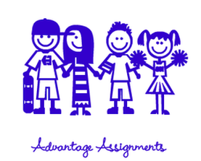
Advantage Assignments
(Note: You must complete regular work in order to get credit for advantage points!)
Advantage Assignments are HW that YOU CHOOSE to do; it’s optional. If you want to do the activity on your own time, go right ahead.
Credit earned for Advantage Assignments will be reflected in your end of the quarter grade as well in your ability to do well in class. This assignment is worth ____ points. Everything will be due by __

Slide 8
Grading
Elementary School converted to Middle/High School
4 = 90 –100 or A – to A+
3 = 80 – 89 or B – to B+
2 = 70 – 79 or C – to C +
1 = 69 & Below or D+ to failing
TOTAL POINTS grading, everything is worth exactly the same amount. 20 points earned for HW is the same as 20 points earned for class work, for a test or quiz. Everything is equal.

Slide 9
Spot Light
Projects – traditional & technology based
P6 Lab Period
Things that are going on in class
Advantage Assignments

Slide 10
Parents
Interdependence (in-ter-di-pen-duhns) - dependence between 2 or more people...
Your kids can't do this alone.
You can't do this alone.
I can't do this alone.
We, your child, you & me, need a team approach.
We need to be interdependent upon one another.

Slide 11
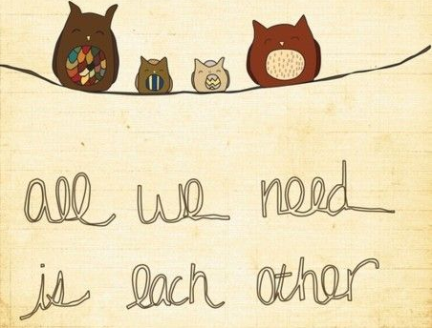
Parents
Interdependent does NOT mean the adults do all the work
Your role: keep yourself informed so that you can support whatever is going on
stop enabling your child & "able" them.
YOU will have more time for YOURSELF … don’t you NEED that?

Slide 12
